Slide 1
Retail Store Analytics Case Study
By :Harsh Singh Chauhan

Slide 2
Introduction
This case study will give us the complete understanding of basic concepts of SAS.
Where we have to import data, clean it, transform and then use it for various reporting.

Slide 3
Learning’s in this case study
After the successful completion of this case study, we will be able to:
Import data in SAS
Store data in SAS
Manipulate Datasets
Query Tables to get required results
Work with formats
Use of Proc SQL and Macros
Use various Data operations such as conditional statements and SAS functions.

Slide 4
Data for case study
Here we are using online retail dataset which consists of the following variables.
Invoice Number (InvoiceNo)
Stock Code ( StockCode)
Description
Quantity
Invoice Date ( InvoiceDate )
Per unit Price (UnitPrice)
Customer ID (CustomerID)
Country

Slide 5
Importing of data
Before going to any Question, First we have to import our Data Set in to SAS Studio
For Importing The Data we use PROC IMPORT method.
PROC IMPORT datafile = "/home/u38470770/OnlineRetail (1).csv" out = project;
RUN;

Slide 6
Case study
After importing the data, we have to perform the following options.
1). Create below transaction and fact tables using the raw transaction data provided:
Transaction table: Invoice number, customer id, product id, quantity, rate, date, time
Customer table: customer id, country
Product table: Product id, product name

Slide 7
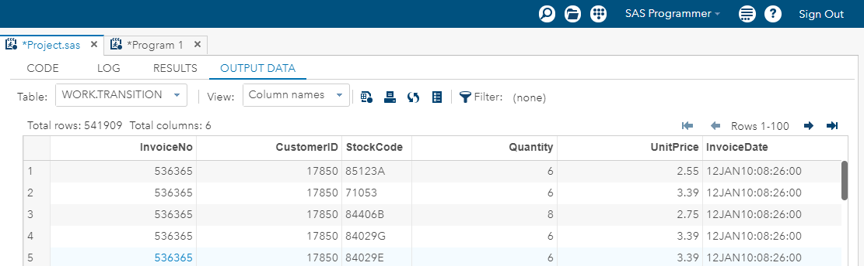
Transaction table
Transaction table consists of Invoice number, customer id, product id, quantity, rate, date, time.
proc sql;
create table Transition as
select Invoiceno, customerid, Stockcode, quantity, unitprice, invoicedate from project ;
quit ;

Slide 8
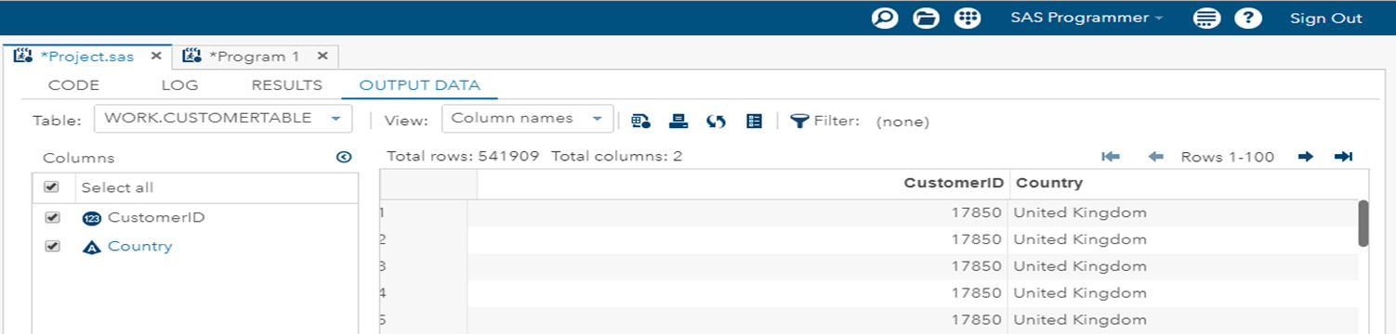
Customer table
Customer Table Consists of customer id, country.
proc sql;
create table customertable as
select customerid,country from project;
quit;

Slide 9
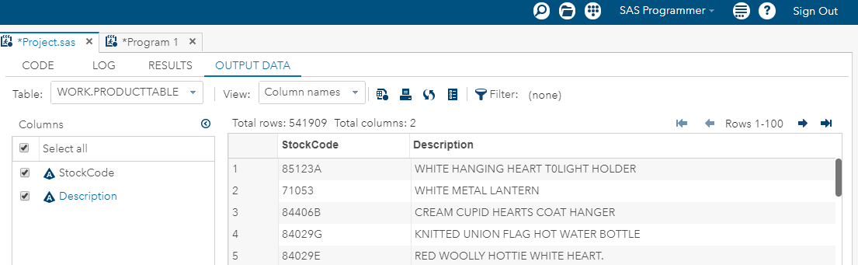
Product table
Product Table consists of Product id, product name.
proc sql;
create table producttable as
select stockcode,description from project;
quit;

Slide 10
Reporting
2). Create a report to get the country-wise breakup of:
most popular product/ most purchased product.
least popular product/ least purchased product

Slide 11
1). Most popular product/ Most purchased product (Country Wise)
proc sql;
create table report as
select country, stockcode,count(stockcode) as cp
from project
group by country, stockcode
order by country, cp desc;
quit;
proc sort data = report;
by country ;
run;
data report2;
set report;
by country;
if first.country;
run;

Slide 12
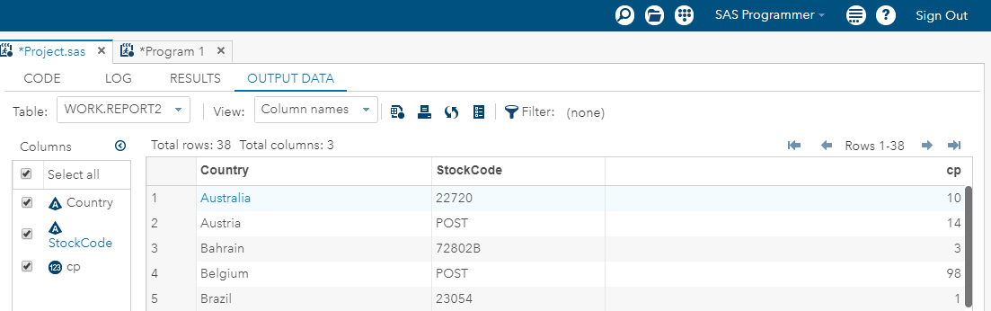

Slide 13
2). Least popular product/ Least purchased product(Country Wise)
proc sql;
create table report as
select country, stockcode,count(stockcode) as cp
from project
group by country, stockcode
order by country, cp desc;
quit;
proc sort data = report;
by country ;
run;
data report2;
set report;
by country;
if last.country;
run;

Slide 14
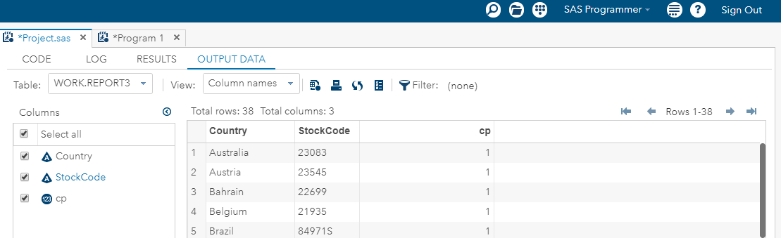

Slide 15
Perform the below operations:
Arrange the customers as per most loyal
Divide them in 3 equal categories according to the total number of customers to provide them with different promotional offers.
Arrange the customer as per most frequent customer in last 2 months.
Find maximum sale day of the previous week according to the day the report is run. The date needs to be kept dynamic.

Slide 16
1).Arrange the customers as per most loyal
proc tabulate data = project out = p1 ;
class customerid;
var quantity;
table customerid ALL , quantity(N) / box = "proc tabulate" ;
run;
proc sql ;
create table loyal as
select customerid,N from p1
order by N desc;
quit;

Slide 17
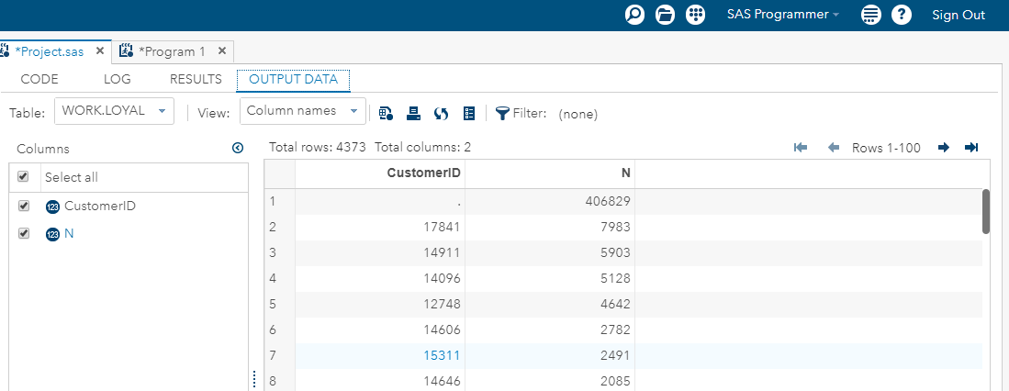

Slide 18
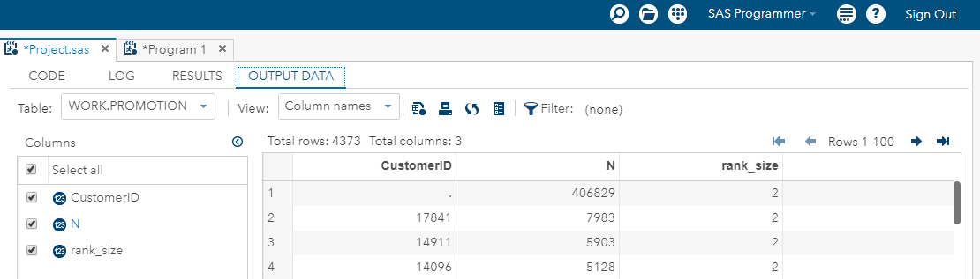
2).Divide them in 3 equal categories according to the total number of customers to provide them with different promotional offers.
proc rank data=loyal out=promotion groups=3;
var N;
ranks rank_size;
run;

Slide 19
Thank You

